Slide 1
DEPARTMENT OF COMPUTER SCIENCE JAWAHARLAL NEHRU TECHNOLOGICAL UNIVERSITY HYDERABAD UNIVERSITY COLLEGE OF ENGINEERING SCIENCE AND TECHNOLOGY HYDERABAD DISSERTATION STAGE-01 DISSERTATION WORK REVIEW-01 AUGUST-2026
PRIVACY-PRESERVING AND COMMUNICATION-EFFICIENT FEDERATED LEARNING FRAMEWORK FOR NON-IID DISTRIBUTED DATA
By:
M . Vyshali
22011P0556
5th year 1st Sem
CSE-IDP
Under the supervision of
Dr. K.Suresh Babu
M.Tech. , Ph.D(CSE)
Professor of CSE

Slide 2
ABSTRACT
A Privacy-Preserving and Communication-Efficient Federated Learning Framework for Non-IID Distributed Data focuses on training a common machine learning model using data stored on different clients without sharing their raw data to a central server.
The main objective of this is to develop a federated learning system that can train a common AI model across multiple clients while protecting their private data and handling differences in client data.
The main problem is that:
Non-IID Data (Non-Independent and Indentically Distributed data): Different clients have different types/distributions of data which make global training difficult
Privacy : Client data should remain private
Communication cost: Sending model updates repeatedly can consume a lot of bandwidth.

Slide 3
4. Imbalanced clients: Some clients mat have much more data or computational power than others
So to overcome all this problems I’m going to develop a federated learning model that can learn effectively from distributed and non-IID data while reducing communication and protecting client information
The final goal is a system that balances accuracy , privacy and communication efficiency.

Slide 4
INTRODUCTION What is federated learning?
Federated learning is am machine learning technique where multiple clients or devices train a common AI model without sharing their raw data with a central server.
Instead of sending the data to the server:
The server sends the global model to clients.
Each client trains the model using its own local data.
Clients send only their model updates to the server.
The server combines the updates to create an improved global model.
The updated model is sent back to the clients.
This process is repeated until the model performs well.

Slide 5
Example :
Imagine 3 hospitals want to build an AI model to detect a disease
Normally:
Hospital1 data + hospital 2 data + hospital 3 data -> central server -> AI model
The problem is that hospitals would need to share sensitive patient data . But sharing sensitive patient data is too risky and can cause communication overhead

Slide 6
Flow chart
Central Server
↓
Global AI Model
↙ ↓ ↘
Hospital 1 Hospital 2 Hospital 3
↓ ↓ ↓
Local data Local data Local data
↓ ↓ ↓
Local model Local model Local model
↘ ↓ ↙
Model Updates
↓
Central Server
↓
Updated Global Model
So that the raw data or sensitive data never leaves the hospitals

Slide 7
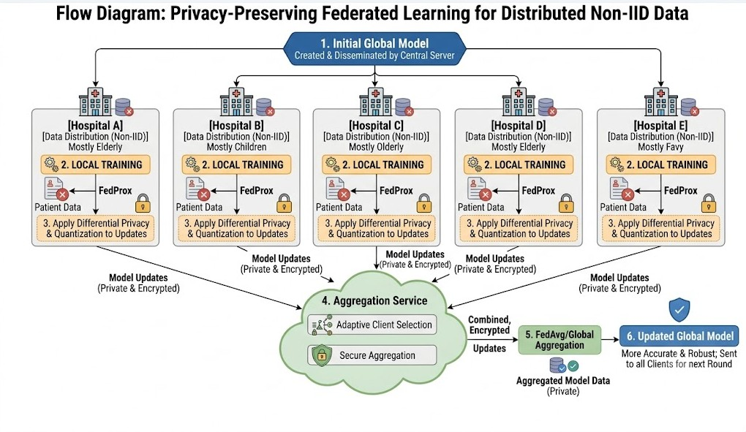

Slide 8
PROBLEM STATEMENT
To develop a Federated Learning system that can handle different client data (Non-IID) while keeping the data private. To reduce communication costs and maintain good model performance during collaborative training.

Slide 9
Objectives of the project
To train a common AI model without sharing raw client data.
To handle Non-IID data using FedProx.
To protect model updates using Differential Privacy.
To reduce communication cost using model quantization.
To compare FedAvg, FedProx, and SCAFFOLD.
To evaluate accuracy, privacy, communication cost, and convergence.
To achieve a good balance between accuracy, privacy, and efficiency.

Slide 10
Differences Between Traditional ML and Federated learning
Traditional ML | Federated Learning
Data is collected centrally | Data stays locally
Raw data is shared | Raw data is not directly shared
Higher privacy risk | Better privacy
Centralized training | Distributed training
Larger data transfer | Only model updates are exchanged

Slide 11
What is Non-IID Data?
Non-IID means Non-Independent and Identically Distributed data
In our project different clients do not have the same distribution of training data
For example:
Client 1 may contain mostly class A data
Client 2 contains mostly class B data
Because clients learn form different data ,their local model updates can move in different directions.
This can cause client drift , slower convergence and lower global model performance
Our project uses FedProx to reduce the effect of these differences

Slide 12
Motivation to do this project ?
Centralized machine learning usually requires data to be collected at one location
For sensitive applications moving raw data to a central server can create privacy and security concerns
In real world distributed environments data is naturally stored across different devices and organizations
The data at these clients is often Non-IID data so federated learning may not perform consistently
Federated learning reduces the need to move raw data ,but model updates can still contain sensitive information

Slide 13
So repeated exchange of large model updates can also create high communication costs
Therefore we want to address privacy ,Non-IID learning and communication efficiency together

Slide 14
Algorithms used and their roles
FedAvg – Baseline model that aggregates client updates using weighted averaging
FedProx- main method for handling Non-IID data and reducing client drift
SCAFFOLD- Comparison model that uses control variates to reduce client drift
Differential privacy-protects sensitive Information in model updates by limiting the effect of individual data contributions
Quantization-Represents model updates with fewer bits to reduce communication size

Slide 15
Step-by-Step Working Process
1. Initialize the global model at the server.
2. Select a group of clients for the current communication round.
3. Send the current global model to those clients.
4. Each client trains locally using its own Non-IID data with FedProx.
5. Generate the local model update.
6. Clip the update and add controlled privacy noise.
7. Quantize/compress the protected update.
8. Send the processed update to the server.
9. Aggregate the client updates to create the new global model.
10. Repeat the process until the model reaches satisfactory performance.

Slide 16
Metrics to evaluate
Accuracy — measures how correctly the global model predicts the target classes.
Precision, Recall and F1-score — provide a more detailed view of model performance.
Communication cost — measures how much information is exchanged during training.
Communication rounds — measures how many server-client rounds are required for convergence.
Convergence speed — shows how quickly the global model becomes stable.
Privacy level — examines the effect of Differential Privacy and its privacy budget.
Non-IID robustness — compares performance under different levels of client data heterogeneity.
Trade-off analysis — studies accuracy versus privacy and accuracy versus communication cost.

Slide 17
THANK YOU

